Slide 1
Michigan Oncology Quality Consortium
Biannual Meeting January 2018
Quality in Daily Practice:
How Can We Make This Work?

Slide 2


Announcements
TODAY’S FEATURE
COMING ATTRACTION
Headshots until 1 pm
CMEs / CEUs
MOQC website
Data behind log on page
(2 weeks from today)

Slide 3
Continuing Medical Education
Disclosures
Jennifer Griggs, MD, MPH, the faculty planner, has no commercial or financial interests, relationships, or other conflicts of interest that are relevant to this activity.
Alexi Wright, MD, MPH, the keynote speaker, has no commercial or financial interests, relationships, or other conflicts of interest that are relevant to this activity.
Please see additional disclosures in the Program.

Slide 4
Continuing Medical Education
Accreditation and Credit Designation Statements
The University of Michigan Medical School is accredited by the Accreditation Council for Continuing Medical Education to provide continuing medical education for physicians.
The University of Michigan Medical School designates this live activity for a maximum of 4 AMA PRA Category 1 Credits™. Physicians should claim only the credit commensurate with the extent of their participation in the activity.
The Michigan Board of Nursing considers ACCME credits acceptable for license renewal or re-licensure.

Slide 5
Continuing Medical Education
Learning objectives:
Analyze experience and improve practice
Integrate relevant content to provide cost-effective health care that does not compromise care quality
Integrate relevant content to ensure multispecialty/multidisciplinary coordination of care
Competencies:
Practice-based learning and improvement
Systems-Based Practice

Slide 6
Continuing Education
If you are interested in receiving credit, you have to:
Complete evaluation forms
Provide your full name and email address
Evaluation forms are provided in the meeting program and at relevant break-out sessions.

Slide 7


For Your Use
On MOQC.org/
Today’s Slides: Monday
Today’s Videos: February 23
Password:
Sign into St. John’s-meetings
uofm18

Slide 8
Accomplishments

Slide 9



New Medical Oncology Practices
MOQC represents 90% of all hematology-oncology providers who are members of BCBSM’s PGIP program

Slide 10

Gynecology-Oncology Practices
MOQC has nearly 100% participation of all gyn-oncologists
13 practices from across the State

Slide 11

2017
Cancer and Hematology Centers of Western Michigan, Grand Rapids
Karmanos Cancer Institute at McLaren Macomb, Mt. Clemens
Memorial Healthcare Cancer Center, Owosso
McLaren Medical Oncology Associates, Lansing
Michigan Medicine, Ann Arbor
Sing & Arora Oncology/Hematology, Flint MI
Practices are in alpha order

Slide 12

Blue Distinction Center – Cancer Care Designation
Congratulations to the following practices who received Blue Distinction Center designations!
  Karmanos Cancer Institute, Detroit
  Michigan Medicine
  Allegiance Health Hematology Oncology
  Karmanos Cancer Institute at McLaren Central MI Morey Cancer Ctr

Slide 13
Blue Distinction Center – Cancer Care Designation
These oncology sites’ associated hospital received the BDC designation:
Genesee Cancer and Blood Disease Treatment Center
Karmanos Bay Hematology Oncology
Karmanos Cancer Institute at McLaren Northern
Karmanos Cancer Institute at McLaren Macomb
McLaren Cancer Institute Bloomfield
McLaren Cancer Institute Clarkston
St. John Hematology Oncology
Michigan State University/Breslin Cancer Center
The BDC Cancer Care program has a rolling application process
Practices will receive a letter of explanation
Reapply for designation when the requirement is addressed

Slide 14
Physician Meeting Participation
Source: Attendance sheets, Biannual and Regional Meetings
Requirement is one physician per practice / 50 practices
*Shared meeting with MiBOQI and Pathways CQIs

Slide 15
Submitting Data to QOPI
96% participation rate from practices
Note: Reported by practice / QOPI number
No data reported in Fall 2014
QOPI certified practices can submit once a year
Number of available practices fluctuates

Slide 16


Slide 17



Regional Quality
Superior East
Central Michigan
Lake Michigan
Metro East
West of Woodward
Superior West

Slide 18
Preliminary Insights & Outputs
Oral versus IV
Role & signature
Revised physician role
Proposed grant submission
Documentation
All patients
Revised materials (video)
Role of PGIP resources
Awareness
Access to services
Prompts for EMR
Plan-Practice initiative

Slide 19
MOQC VBR
Two Requirements Need to be Met
Management of Pain
  Initial therapy
  End of life
Tobacco cessation counselling administered or patient referred in last year
Hospice enrollment, palliative care referral/services or documented discussion
Physician attendance at 1 of 2 biannual meetings*
Physician attendance at Spring & Fall evening regional meetings
Region meets target for 4 measures
+
Attendance at Biannual & Regional
*exceptions are available to practices

Slide 20
Changes for 2018
Attendance requirements
No
Measures for Pathway
Yes
VBR Measures
No
Number of VBR Measures
Yes
VBR Targets
Yes

Slide 21
Committee/Group Structure
MOQC Steering Committee
MOQC Coordinating
Center
Patient and Caregiver Oncology Quality Council (POQC)
Measures
Group
Advanced Imaging
(proposed)
Practices

Slide 22
Steering Time Commitment
Voluntary and Advisory
Attendance at Biannual meetings
4 meetings a year
    2 in-person at Biannual
    2 teleconferences
Review agenda, documents and feedback via email
Participate occasionally in an time-limited workgroup

Slide 23

Nomination Process
Complete and leave cards on table
Propose yourself or a colleague
Minimum of 2 physicians per region
Steering Committee is inter-disciplinary; submit name of a non-physician
Email by next Friday (2/2/18)
lbedard@moqc.org

Slide 24

Oncology Communication, Technology, and EvenTs Study(OCTET)
Christopher R. Friese, PhD, RN, AOCN®, FAAN
Jennifer J. Griggs, MD, MPH, FASCO
Milisa Manojlovich, PhD, RN, CCRN
Molly Harrod, PhD
Kai Zheng, PhD

Slide 25
Project Specific Aims
1. Characterize clinician communication processes, technologies, & adverse events
2. Examine how communication & technologies affect practice
3. Assess barriers & facilitators to safer cancer care
Year 1 – Aim 1
In all MOQC practices
Survey clinicians & patients
Practice characteristics
Technology maturity index
Year 2 – Aim 2
In 8 selected sites
Observation, shadowing, patient interviews
Year 3 – Aim 3
At a MOQC meetings
Focus groups of clinicians and practice leaders
Completed
In Process

Slide 26
Year 1 Participation
In 2017, 28 MOQC practices participated
Data received from
  2,223 patients – toxicities reported in past week
  PRO-CTCAE™ (nausea, vomiting, constipation, diarrhea, neuropathic pain, and general pain)
  184 nurses – communication and technology
  114 prescribers – communication and technology
Overall participation: 68%, (50-100% across MOQC)

Slide 27
Year 1 Patient Data
Preliminary Results, Not for Distribution
Unadjusted for patient severity or treatment intensity
20% rated ≥one toxicity as severe/very severe in the past week
  Pain 13%
  Neuropathy 6%
  Constipation 5%
7% used additional health care services to manage a toxicity in the past week

Slide 28
Year 2 Clinician Data
Preliminary Results, Not for Distribution
Clinician communication (20-item score, higher is better)
Satisfaction with EHR/Documentation
(5-point scale, higher is more satisfied)

Slide 29
What’s next
Interim reports to practices next week
ASCO and AcademyHealth Abstracts
Analyze patient, clinician, and daily log data
Identify patterns and correlates of favorable patient and clinician outcomes
Approach 8 MOQC practices to participate in Aim 2: 1-week observational study
(U-M IRB approved, ≤minimal risk, sites “not engaged”)

Slide 30
Acknowledgments
Participating practices and your patients
MOQC Leadership and staff
OCTET study team
Agency for Healthcare Research and Quality (AHRQ)
Questions?
octet-study@umich.edu
734-615-4017

Slide 31
Next Steps

Slide 32

MOQC Deliverables to Practices
Follow up/touch base on regional projects
Steering Committee member announcements
PGIP payment schedule
Launch of MOQC data

Slide 33
Regional Meetings – Save the Date
Schedule Your Physician and Administrative Partner
Region | Spring | Fall
Metro East | Tuesday April 10 | Tuesday November 6
LMOR | Thursday April 12 | Thursday November 8
WOW | Tuesday April 17 | Tuesday November 13
CMG | Thursday April 19 | Thursday November 15
Superior West | Wednesday May 2 | Wednesday October 10
Superior East | Thursday May 3 | Thursday October 11

Slide 34
Next Biannual Meetings
A physician per practice must attend one meeting
MOQC BIANNUAL MEETINGS
Friday June 22 2018 | Amway Plaza | Grand Rapids
Friday January 19 2019 | Inn at St. John’s | Plymouth

Slide 35

MOQC Members Extraordinaire
Deneil Harney
Katlyn LaVasseur
Tiffany Peters
Cindy Straight
Cindy Michalek

Slide 36

The winners are . . .
For Use in Your Practice

Slide 37

The winners are . . .

Slide 38

The winners are . . .

Slide 39
Closing Comments
Email us: first initial, last name@mocq.org
Telephone us: (734) 232-0043
Visit www.moqc.org
Pick up MOQC luggage tag and scarf
Leave iClickers on the tables
Hand in evaluation forms for CME/CEU credits
Travel safely

Slide 40
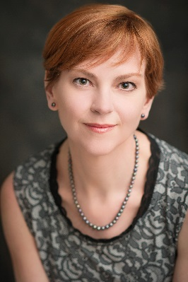
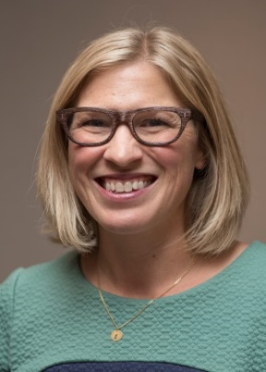
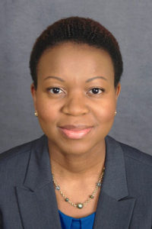
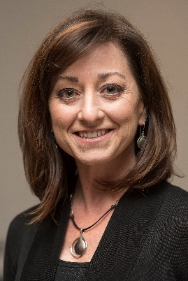
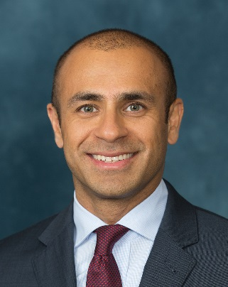
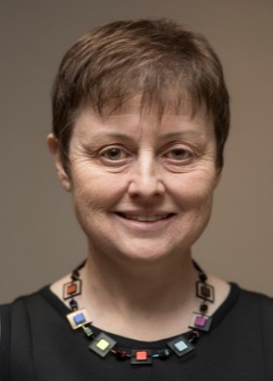
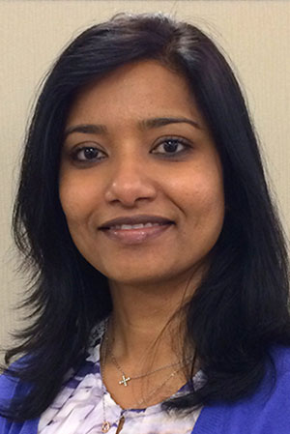
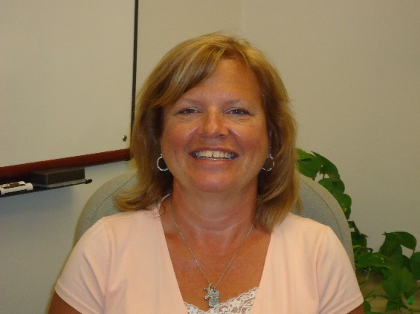
Thank You & See You Soon
Jennifer J. Griggs
Program Director
Emily Mackler
Clinical Pharmacist
Sam Beusterien
Project Manager
Jennifer Yanchula
Outreach Manager
Shitanshu Uppal
Program Co-Director
Louise Bedard
Program Manager
Arthi Ramakrishnan
Project Manager
Mary Wines
Administrative Specialist

